Slide 1
AIC Roadmap for a sustainable food chain
www.aicroadmaps.org.uk

Slide 2
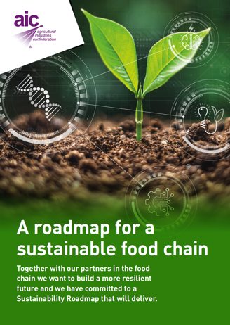
AIC Roadmap for a sustainable food chain
    Our Objectives:
    To agree a common direction of travel and end goals
    Create our future
    Be part of the solution
    Be clear on our role and intentions
    Provide a framework for members to buy into
    Create momentum for change with our food chain partners
    Monitor progress and collate metrics

Slide 3
The Roadmap is shaped by a ‘picture of the future’
  Existing UK Government policies/targets extending out to 2050. These signal intention/commitments beyond any single Government administration.
  It deals with production of Agri-inputs to responsibilities for their Consumption (safe use on farm)
  We ask for a similar ‘Production to Consumption’ approach for future policy interventions – to avoid the UK offshoring food production, economic viability, social and environmental obligations.

Slide 4
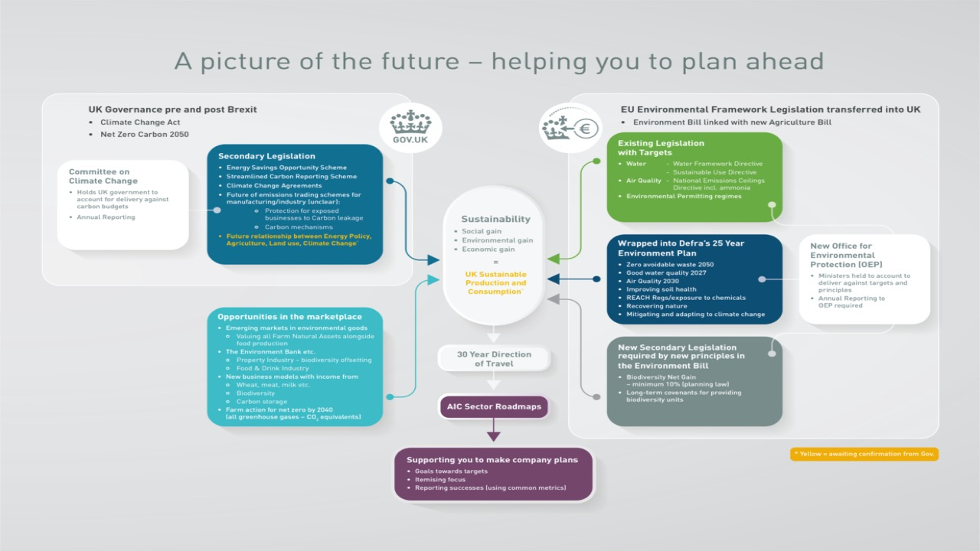

Slide 5
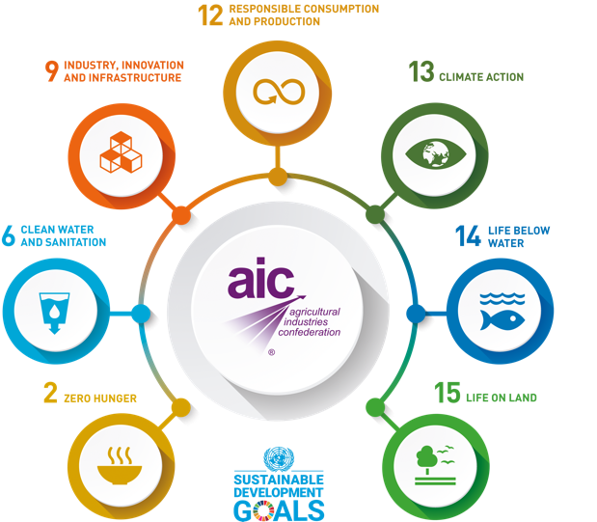
Accounting for the wider UK obligations to meet UN sustainability goals

Slide 6
Our Roadmap addresses every aspect of sustainability to drive solutions which deliver:
SOCIALLY
for our industry and society at large
ECONOMICALLY
for business and country interests as part of the food, drink and energy economy
ENVIRONMENTALLY
for soil, water, air, climate change and adaptation and biodiversity

Slide 7
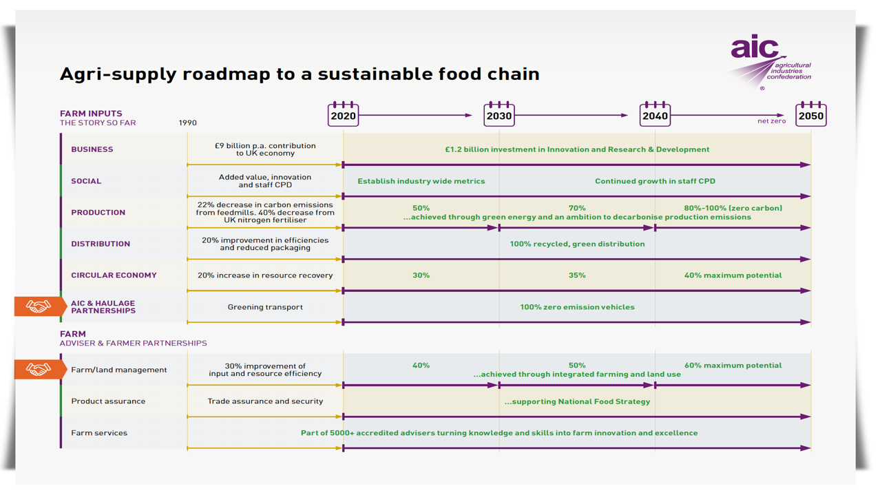

Slide 8
Headline commitments to sustainability
£1.5 Billion investment in future farm applied research, technology and innovation
Ensuring diversity of seeds & seed traits to support the UK’s sustainable food production strategy
Decarbonisation of fertiliser manufacture, building farm production sustainably with soil health, farm nutrient balance and efficiency
Green energy at feedmills and maximum potential nutrient recovery from the food supply chain
for the next 30 years

Slide 9
Headline commitments to sustainability cont.
Greening of processing, storage and distribution of agri-supply materials while maintaining assurance standards
New technologies supporting Integrated Pest Management
Footprinting of UK crops and animal feeds compared to other parts of the world, to inform trading decisions and sourcing of raw materials
Expanding the skill set of our farm advisers to offer integrated farm and sustainable land management solutions
for the next 30 years

Slide 10
Sustainability Training
for Boards and operators
Company benchmarking
Common Metrics
Communication
Alliances for action
Implementation for business

Slide 11
This is a dynamic challenge, involving all
Our Roadmap provides the framework for individual company, sector and cross sector action
The exact course of action is yours
AIC sector heads can help facilitate

Slide 12
www.aicroadmaps.org.uk

