Slide 1
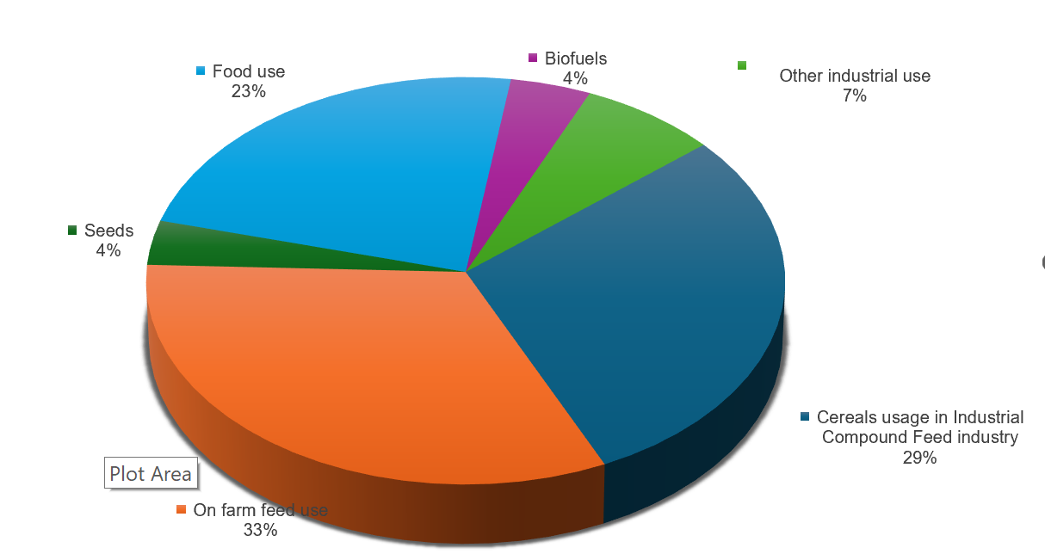
EU-27 use of domestically produced cereals in 2022-23
Source: FEFAC, DGAgri

