Slide 1
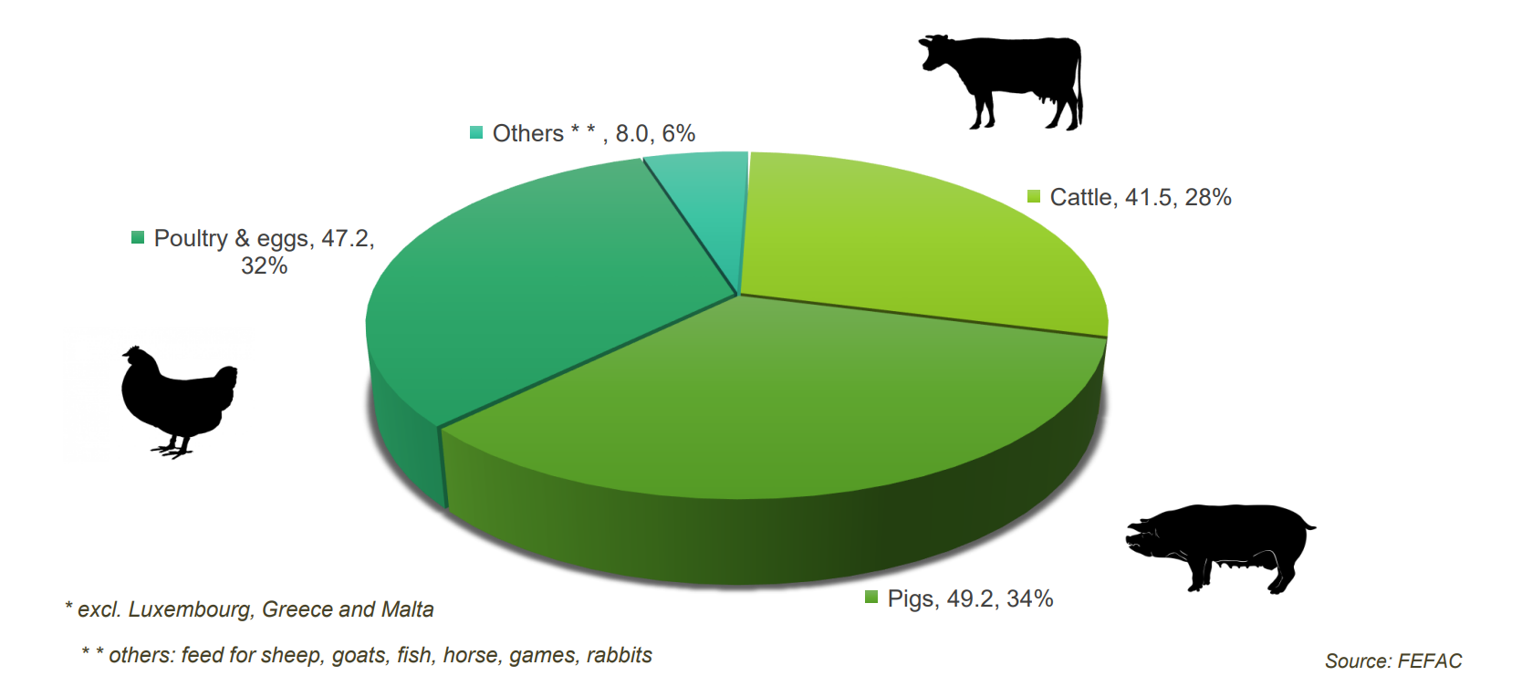
Compound feed production in the EU-27 in 2022 by livestock type
145.1mt

